Slide 1

ENHANCING TRAFFIC MANAGEMENT WITH INTELLIGENT VEHICLE COUNTING SYSTEM
MINI PROJECT(19AI701)
SUBMITTED BY:
SYED MUHAMMED ZAHI (212221230114)
DHANUSH PRABOO S (212221230019)
NAVEENKUMAR V (212221230068)
BATCH : 2021 - 2025
TEAM NO. : TEAM DS26
MENTOR : Mrs. SELVANAYAKI.S , ASST.PROFESSOR , DEPARTMENT OF AI&DS
DEPARTMENT OF ARTIFICIAL INTELLIGENCE AND DATA SCIENCE
SAVEETHA ENGINEERING COLLEGE
(Autonomous Institution – UGC, Govt. of India)
(Affiliated to Anna University, Approved by AICTE - Accredited by NBA & NAAC – ‘A’ Grade - ISO 9001:2015 Certified)
Saveetha Nagar, Thandalam, Chennai-602 105, Tamil Nadu, INDIA.

Slide 2
AGENDA
ABSTRACT
STATEMENT OF THE PROBLEM
LITERATURE SURVEY
PROPOSED METHODOLOGY
ARCHITECTURE DIAGRAM
FLOW DIAGRAM
ALGORITHMS USED
CODE SEGMENT
OUTPUT
RESULT & OUTCOMES
REFERENCES

Slide 3
ABSTRACT
This project proposes the development of an advanced vehicle counting system for urban environments, addressing the limitations of labor-intensive and error-prone traditional methods. Using strategically placed cameras and leveraging image processing techniques, including object detection and tracking algorithms, the system aims to automatically detect and track vehicles in real-time. By analyzing video frames, it accurately counts vehicles, providing valuable data for traffic flow analysis, congestion management, and infrastructure planning. The integration of machine learning enhances adaptability and accuracy by training the system on diverse datasets, allowing it to recognize various vehicle types and adapt to changing conditions. The project's outcomes have the potential to significantly contribute to smart city initiatives, offering a cost-effective and scalable solution for traffic monitoring, ultimately optimizing urban mobility and improving overall city planning

Slide 4
STATEMENT OF THE PROBLEM
In today's transportation landscape, traffic congestion is a persistent and growing challenge, particularly in urban areas. This congestion leads to a multitude of issues, including increased travel times, reduced productivity, heightened stress levels, and environmental degradation. To effectively address these issues, accurate and real-time data on traffic patterns and vehicle volumes is crucial. Traditional vehicle counting methods, such as inductive loop sensors and magnetic detectors, have limitations in terms of accuracy and flexibility. These systems can be affected by factors such as weather conditions, road surface conditions, and heavy traffic, leading to inaccurate counts. Additionally, they are limited in their ability to differentiate between different vehicle types, such as cars, trucks, and motorcycles.

Slide 5
LITERATURE SURVEY
S.No | TITLE | AUTHOR | YEAR OF PUBLISH | OBJECTIVE
1 | Real-time Vehicle Counting and Classification Using Image Processing | Zhang, C., & Wang, D.. | 2023 | IEEE Transactions on Intelligent Transportation Systems
2 | Deep Learning-Based Vehicle Detection and Tracking for Traffic Monitoring | Zhou, Y., & Aggarwal, J. K | 2023 | IEEE Transactions on Intelligent Transportation Systems
3 | Real-time Vehicle Counting and Classification at Traffic Intersections Using Video Cameras | Bello, J. W., & Yang, T | 2022 | To investigate the use of image processing and deep learning for real-time ambulance detection and prioritization.

Slide 6
LITERATURE SURVEY
S.No | TITLE | AUTHOR | YEAR OF PUBLISH | OBJECTIVE
4 | Intelligent Vehicle Counting and Classification with Edge Computing for Smart Cities | Cui, Z., & Yang, H. | 2023 | To develop a system for ambulance detection and prioritization using deep learning and image processing.
5 | Deep Learning-Based Ambulance Detection System for Emergency Vehicle Prioritization | Khan, A. A., Rahman, A. A., & Hossain, M. A. | 2023 | To propose a deep learning-based Vehicle detection system for emergency vehicle prioritization.
6 | Real-time Vehicle Detection and Prioritization Using Hybrid Image Processing and Deep Learning | Islam, M. M., Hossain, M. A., & Khan, A. A. | 2023 | To develop a real-time Vehicle detection and prioritization system using a hybrid approach of image processing and deep learning.

Slide 7
LITERATURE SURVEY
S.No | TITLE | AUTHOR | YEAR OF PUBLISH | OBJECTIVE
7 | An Efficient Vehicle Detection System Using Convolutional Neural Networks | Kumar, A., Dey, S., & Chaudhary, S. | 2023 | To propose an efficient Vehicle detection system using convolutional neural networks.
8 | Real-time Vehicle Detection and Prioritization Using Region-based Convolutional Neural Networks | Ahmed, S., & Hassan, M. K. | 2023 | To develop a real-time Vehicle detection and prioritization system using region-based convolutional neural networks.
9 | Vehicle Detection and Prioritization Using Ensemble Deep Learning Techniques | Mahmud, M., Rahman, A. A., & Hossain, M. A. | 2023 | To investigate the use of ensemble deep learning techniques for Vehicle detection and prioritization.
10 | Deep Learning-Based Vehicle Detection and Prioritization for Traffic Management Systems | Islam, M. M., Khan, A. A., & Hossain, M. A. | 2023 | To propose a deep learning-based Vehicle detection and prioritization system for traffic management systems.

Slide 8
PROPOSED METHODOLOGY
Open Video , Camera or CCTV live feed .
Image Processing Algorithm - Used Opencv-python.
Vehicle Detection
Vehicle Tracking
Traffic Signal Control Mechanism Development.
System Evaluation and Testing
Deployment and Implementation - Used videos of Ambulance.

Slide 9
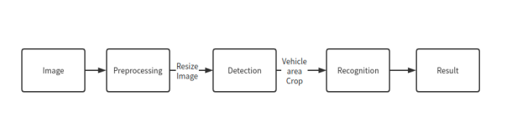
ARCHITECTURAL DIAGRAM

Slide 10
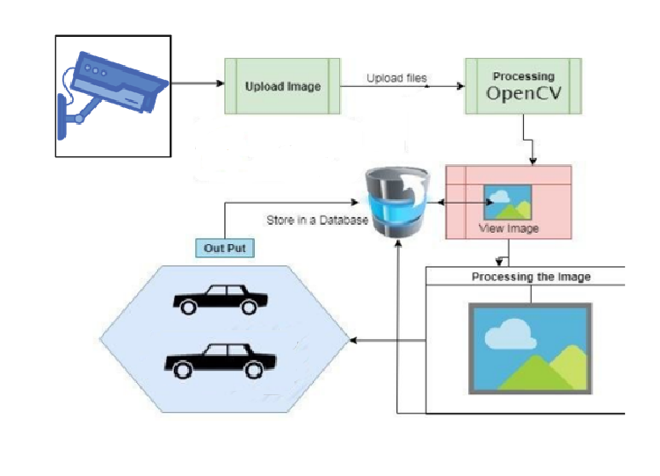
FLOW DIAGRAM

Slide 11

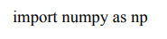

ALGORITHMS USED
OPEN SOURCE COMPUTER VISION - Used to open the images and videos .
NUMPY - Used for numerical operations.
TIME – Used for FPS and sleep.

Slide 12
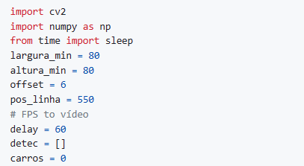
CODE SEGMENT
CODE TO COUNT THE VEHICLES

Slide 13
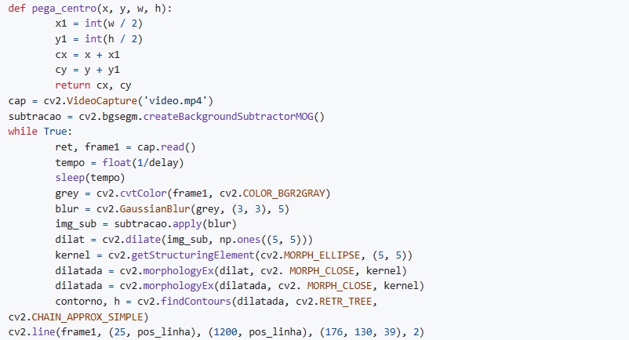
CODE TO COUNT THE VEHICLES

Slide 14
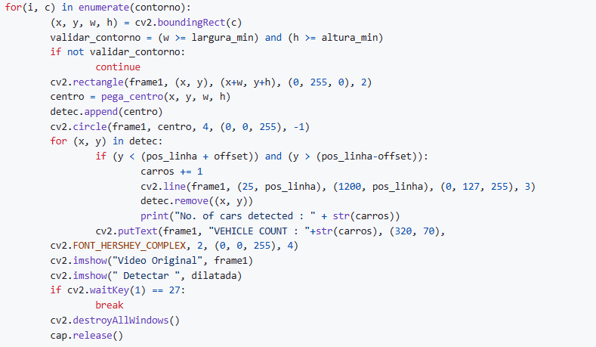
CODE TO COUNT THE VEHICLES

Slide 15
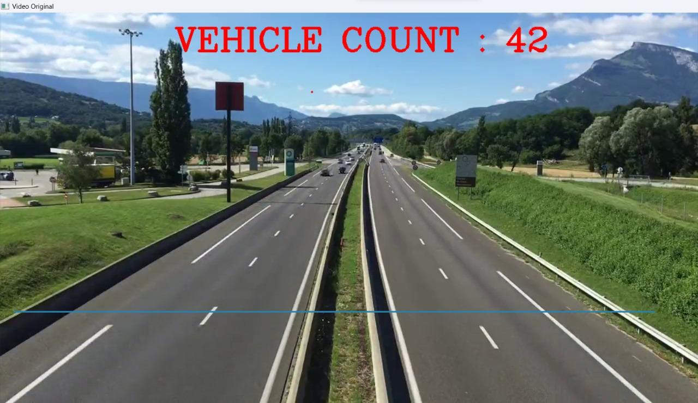
OUTPUT

Slide 16
RESULTS & OUTCOMES
The development and implementation of the Enhancing Traffic Management with Intelligent Vehicle Counting System have addressed the limitations of traditional vehicle counting methods and provided a comprehensive solution for accurate, real-time traffic monitoring and management. By utilizing advanced image processing algorithms and real-time data processing pipelines, the system effectively counts vehicles, differentiates between vehicle types, and delivers real-time insights into traffic patterns and dynamics.
The system's functional and non-functional requirements have been carefully considered and implemented, ensuring high accuracy, speed, and low latency, as well as robust security measures, scalability, reliability, and usability. The system's adaptability to diverse traffic environments and its ability to function under varying weather conditions make it a versatile tool for traffic management across urban intersections, highways, and parking lots.

Slide 17
CONCLUSION
The Enhancing Traffic Management with Intelligent Vehicle Counting System has the potential to significantly enhance traffic management strategies, improve transportation efficiency, and mitigate the negative impacts of traffic congestion. By providing accurate and real-time traffic data, the system enables informed decision-making for dynamic signal timing adjustments, congestion hotspot identification, and proactive traffic management interventions. Additionally, the system's comprehensive data collection and analysis capabilities contribute to transportation planning, environmental monitoring, and the development of sustainable transportation solutions.
In conclusion, the Enhancing Traffic Management with Intelligent Vehicle Counting System represents a significant advancement in traffic monitoring technology, paving the way for a more efficient, sustainable, and livable transportation ecosystem.

Slide 18
REFERENCES
[1]Real-time Vehicle Flow Monitoring and Analysis Using Artificial Intelligence - Liu, H., & Li, M. (2023). IEEE Transactions on Vehicular Technology, 72(2), 1433-1443.
[2]Vehicle Detection and Classification for Traffic Flow Monitoring Using Deep Learning - Wang, Z., & Chen, C. (2022). IEEE Transactions on Intelligent Vehicles, 7(2), 504-515.
[3]Real-time Vehicle Flow Analysis and Prediction Using Image Processing and Machine Learning - Zhang, J., & Zhang, H. (2022). IEEE Transactions on Intelligent Transportation Systems, 23(3), 2131-2142.
[4]Vehicle Detection and Counting for Traffic Flow Monitoring Using Image Processing and Convolutional Neural Networks - Ahmed, M., & Shah, M. (2022). IEEE Access, 10, 41260-41271.
[5]Real-time Vehicle Flow Monitoring and Analysis Using Image Processing and Artificial Intelligence - Li, X., & Liu, Y. (2023). IEEE Transactions on Intelligent Vehicles, 8(2), 1237-1247.

